Slide 1
Title I Agenda
MARSHALL
ELEMENTARY
Title I AGENDA
Purpose of Title I for Students
Curriculum
Review of Assessments
Requirements for Proficiency
Academic Family Engagement
Tuesday, August
6:30 PM

Slide 2
MARSHALL ELEMENTARY Title I Program Home of the MUSTANGS
Annual Title I Parent Meeting Date: 8-22-2023

Slide 3
The purpose of Title I is to ensure that all students …
…receive a high-quality education
…from appropriately certified, well-trained staff
…who use evidence-based instructional methods

Slide 4
Grants
Marshall Elementary
has been allocated
$134.608
in Federal Title I dollars for
School Year 2023-2024

Slide 5
Title I Funds are for…
supporting struggling learners with additional resources and help in reading and mathematics.

Slide 6
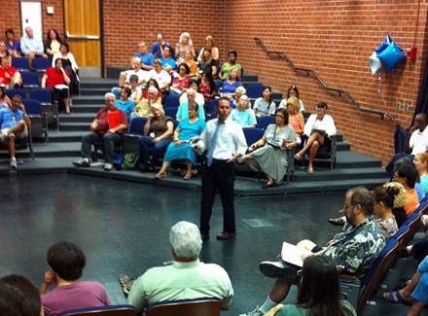
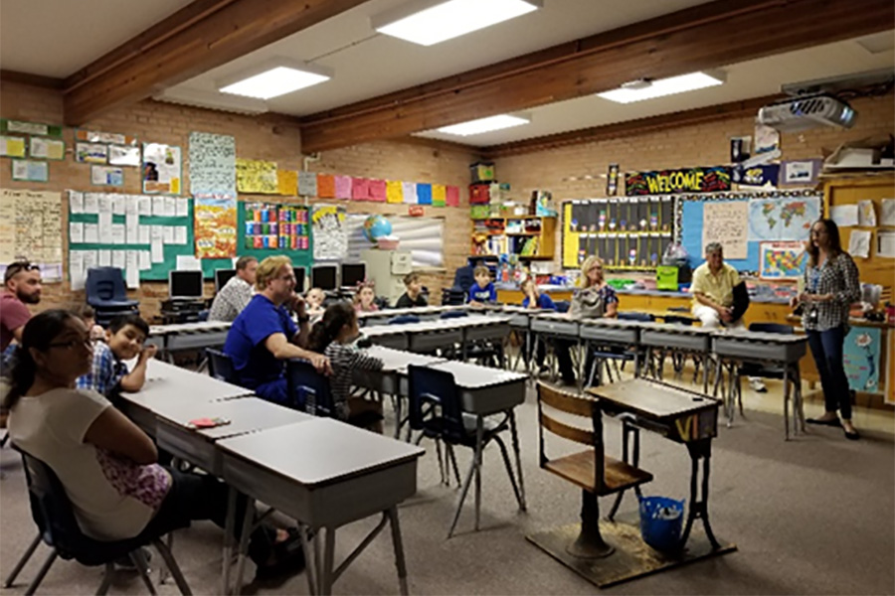
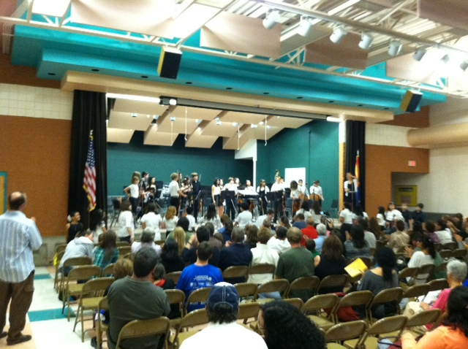
Title I funds help our school offer families
interactive learning opportunities
to
support student achievement at high academic levels

Slide 7
Arizona’s Academic Standards Assessment (AASA)
ELA-Reading | Math
3rd Grade 27% | 31.6%
4th Grade 54.3% | 52.8%
5th Grade 50% | 44.1%

Slide 8
School Letter Grade
The Arizona Department of Education (ADE) assigns each school a letter grade based on spring 2022 Arizona’s Academic Standards Assessment results. When the information is received, we will notify our community.
School grades are based on:
The percentage of students who passed the Arizona’s Academic Standards Assessment (AASA) exam.
The percentage of students who attained academic growth reaching or exceeding grade level expectations.
Additional factors such as the percentage of students evaluated, graduation rate-High School Only, reclassification of English language students.
Title I funds help our school maintain / improve our school score by improving student achievement through the strategic use of federal funds.

Slide 9
Integrated Action Plan (IAP)
Our school leadership team composed of staff and families completed a needs assessment in the spring. We address student needs and allocate Title I resources to support:
Well trained staff using effective teaching practices
To provide intervention for struggling students
Families to help students achieve in school
**To participate in our planning process, please contact:____________

Slide 10
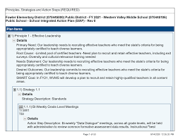
Integrated Action Plan (IAP)
To ensure that all students receive a high-quality education we employ appropriately certified staff, who use research based instructional methods. Our school plan includes the following:
90 minutes of regular reading instruction per day.
60 minutes of regular mathematics instruction per day
Teacher Training in Guided Reading and Small Group Instruction
Curriculum Service Providers to support teachers with analyzing data, providing curriculum, and providing support.

Slide 11
Integrated Action Plan (IAP)
To support struggling learners with additional resources and help in reading and mathematics, our school plan to improve reading achievement includes the following:
Reading/Math Interventions
30 minutes per day
Additional Reading/Math Classes
15 minutes of additional instruction daily
Reading/Math Tutors, Tutoring will be held before and after school, dates TBA.  To inquire about our tutoring program, please Sarah Riebe at 731-4960  Reading/Math Volunteers to inquire about our tutoring program, please Sarah Riebe at 520-731-4960
Other action steps: Reading Mentors

Slide 12
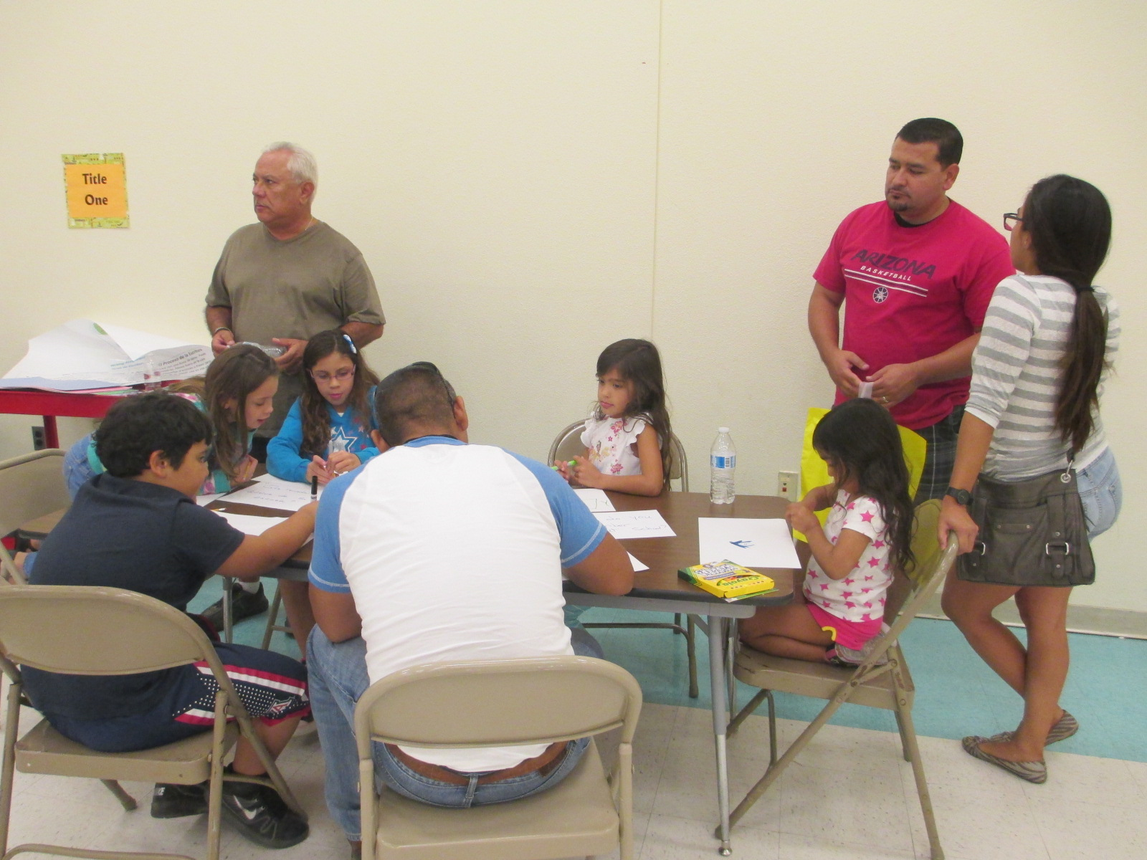
School Integrated Action Plan (IAP)
Academic Family Engagement
Our plan includes steps to promote academic family engagement:
District Parent Involvement Policy
School Parent Involvement Policy
Title I Parent Compact
TUSD Family Centers
Academic Family Engagement Calendar and
Events will be announced by using:
Parent Link
Newsletters
Marshall Webpage
Marshall Marquee
Teacher Webpage/Communication

Slide 13
Parents Right to Know
You have the right to request:
The qualifications of your child’s teacher and instructional staff
Your child’s level of achievement based on required state assessments
You must be informed within 4 weeks if:
Your child is being taught by a teacher who does not meet the appropriately certified requirements of the state
All of this information must be in a language and format that is understandable to you.

Slide 14
Important Dates to Remember
Parent Teacher Conference
September 20, 21, 22
February 8, 9
Student Progress Reports (all Progress Reports will be online on ParentVUE)
October 17, January 9, March 19, May 23
Updates to the school integrated action plan, the parent policy and compact
September 20
November 1
January 23
March 27
For more information or to access the school Integrated Action Plan Contact:
School Principal: Emily Suess
Email: Emily.suess@tusd1.org
School Phone: 520-731-4900

Slide 15
Thank you!
If you have any questions, concerns, or comments, please contact,
School Principal: Emily Suess
Email: Emily.suess@tusd1.org
School Phone: 520-731-4900

